Slide 1

Introduction To .NET Framework

Slide 2
What is .NET:
.NET is a Framework used to build ,design , develop and deploy the applications.
It supports more than 300 languages.
Among those 11 were developed by the Microsoft(c#.net ,VB.net ,c++.net ,etc)
It supports running websites, services, desktop apps, and more on Windows.
It provides language interoperability.

Slide 3
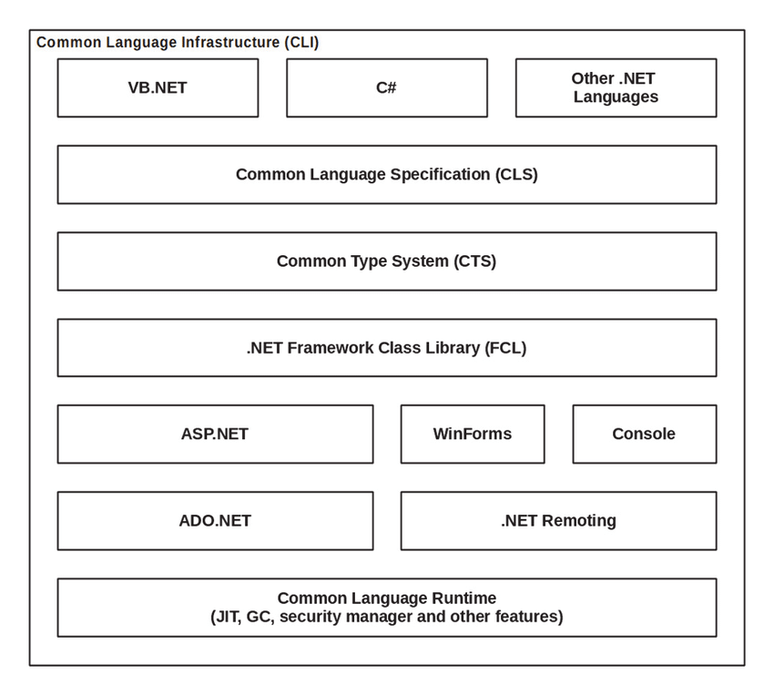
.NET Architecture:

Slide 4
Components:
CLR (Common Language At Runtime)
CTS (Common Type System)
CLS (Common Language Specification)
FCL (Framework Class Library)
MSIL (Microsoft Intermediate Language)
JIT (Just In Time)

Slide 5
CLR:
It is the run-time environment in the .NET Framework that runs the codes and helps in making the development process easier by providing the various services.
Basically, it is responsible for
Code Debugging:
Assigns corresponding compiler to the corresponding code.
Exception Handling:
Can handle runtime exceptions.
Security:
Only authorized persons can compile/run/debug the code.

Slide 6
Contd..
Version Support:
Code written in lower version is automatically updated to the higher version when compiler.
Garbage Collector:
It is used to provide the Automatic Memory Management feature.
If there was no garbage collector, programmers would have to write the memory management codes which will be a kind of overhead on programmers.

Slide 7
FCL:
Framework Class Library provides the system functionality in the .NET Framework as it has various classes, data types, interfaces, etc.
Libraries are the predefined functions which are grouped together and placed in a common place.
The functionality of the Framework Class Library can be broadly divided into three categories
Utility Features: The utility features in the FCL includes various collection classes such as list, stack, queue, dictionary, etc.
Wrappers Around OS functionality
Frameworks: There are various frameworks available in the FCL to develop certain applications. For example, ASP.NET is used to develop web applications.

Slide 8
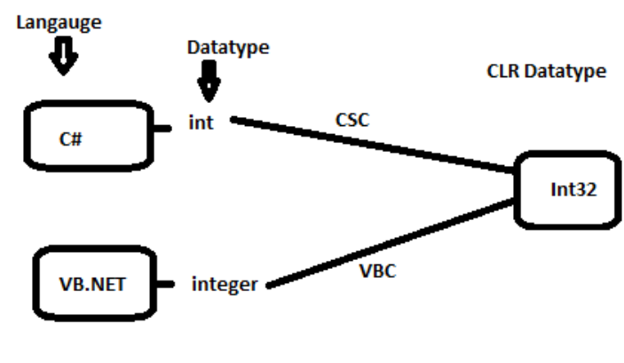
CTS:
Common Type System (CTS) describes the datatypes that can be used by managed code.
All .NET framework languages needs to undergone one common state.
For example: C# has an int data type and VB.NET has Integer data type. Hence a variable declared as an int in C# and Integer in VB.NET, finally after compilation, uses the same structure Int32 from CTS.

Slide 9
CLS:
CLS stands for Common Language Specification and it is a subset of CTS.
CLS provides the code interoperability.
The code which is in one language can be used in another language.

Slide 10
MSIL:
MSIL means Microsoft Intermediate Language. Also known as CLI(Common Intermediate Language).
Before the code is converted into native machine code ,it is converted to MSIL.
And then the JIT compiler converts the MSIL into native code.

Slide 11
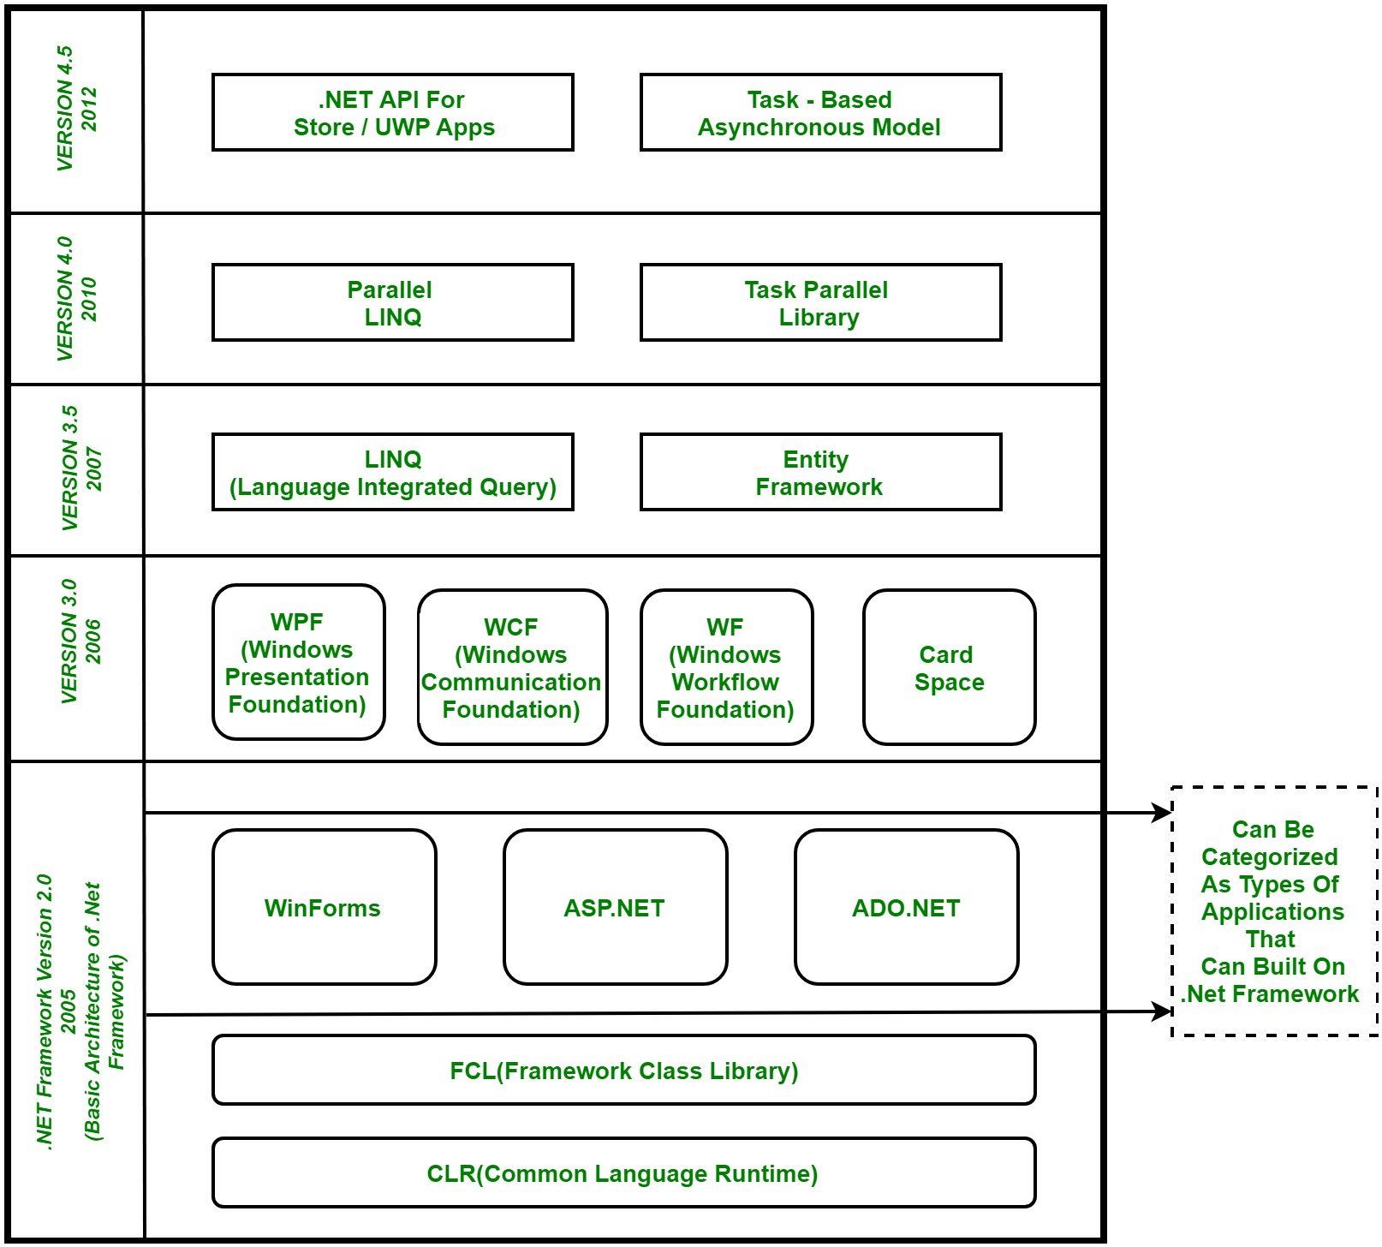
Features:

Slide 12
Features:
WPF (Windows Presentation Foundation) : Windows Presentation Foundation (WPF) is a graphical subsystem given by Microsoft which uses DirectX and is used in Windows-based applications for rendering UI (User Interface).
WCF (Windows Communication Foundation) : It is a framework for building connected and service-oriented applications used to transmit the data as asynchronous from one service endpoint to another service point. It was previously known as the Indigo.
WF (Windows Workflow Foundation) : It is a technology given by Microsoft which provides a platform for building workflows within .Net applications.
LINQ (Language Integrated Query) : It is introduced in .Net framework version 3.5. Basically, it is a query language used to make the query for data sources with VB or C# programming languages.
Parallel LINQ (Language Integrated Query) : It comes in .Net Framework version 4.0 and also termed as PLINQ. It provides a concurrent query execution engine for LINQ. It executes the LINQ in parallel such that it tries to use as much processing power system on which it is executing.

Slide 13
THANK YOU

